Slide 1
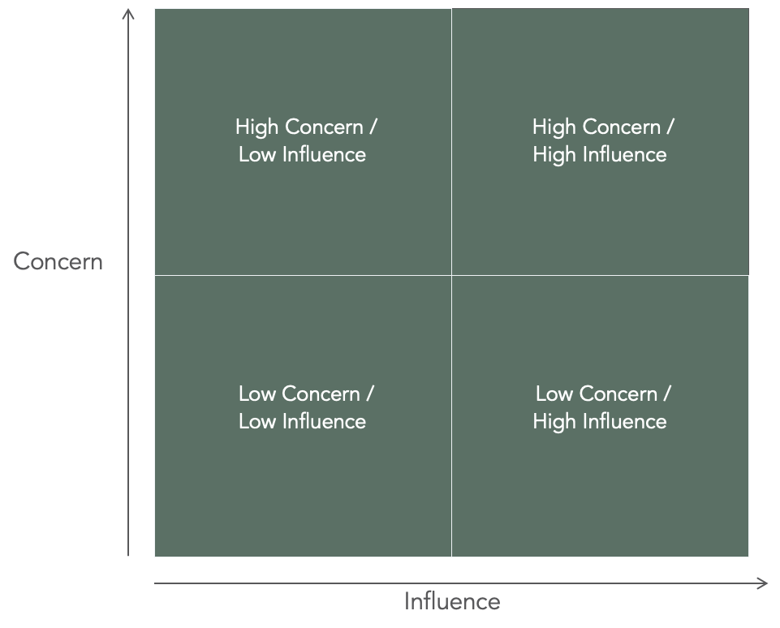
STAKEHOLDER RATING
I TEMPLATE
High Concern /
Low Influence
High Concern /
High Influence
Concern
Low Concern /
Low Influence
Low Concern /
High Influence
Influence
Notes:
Bruges til opsamlingen i plenum

